Slide 1
The Art of Mindful Living

Slide 2
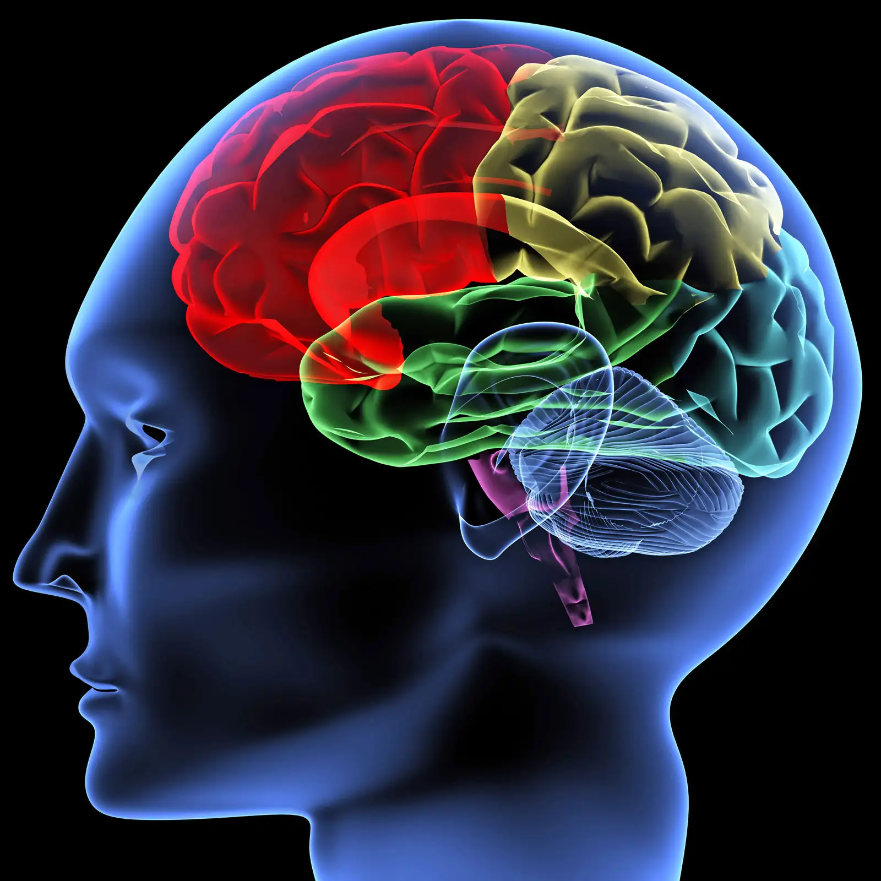
Your Brain has all the power connections, wiring, storage, memory and processing power you need to function as human being.

Slide 3
If your Brain is the hardware, then your mind is the Software.

Slide 4
It’s the operating system that gathers, stores and manages information, using the massive processing resources of your brain.

Slide 5
Conscious Mind
Sub Conscious Mind
Unconscious Mind

Slide 6
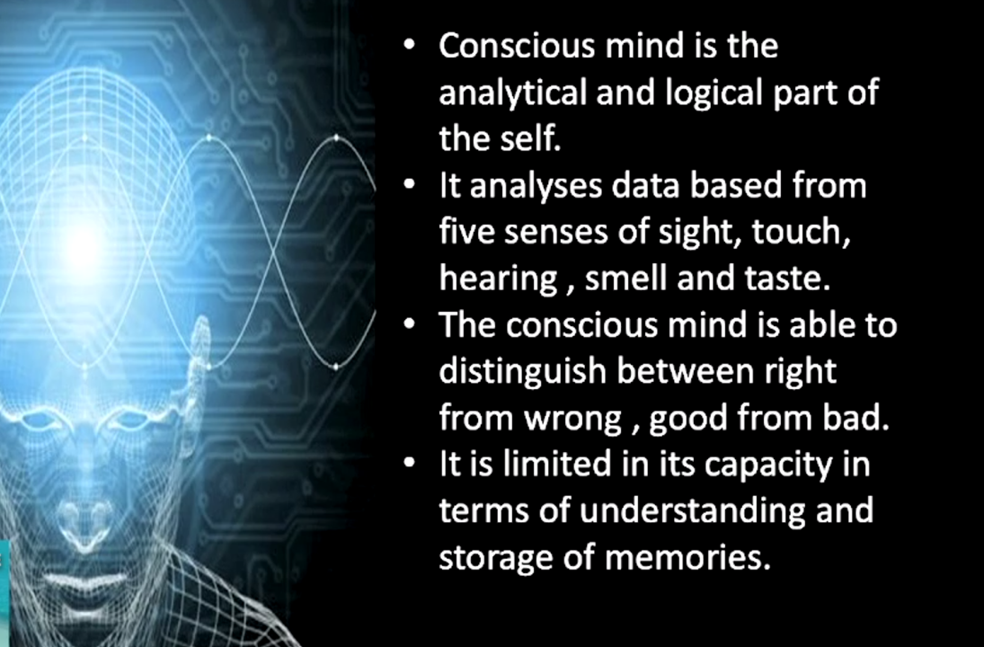
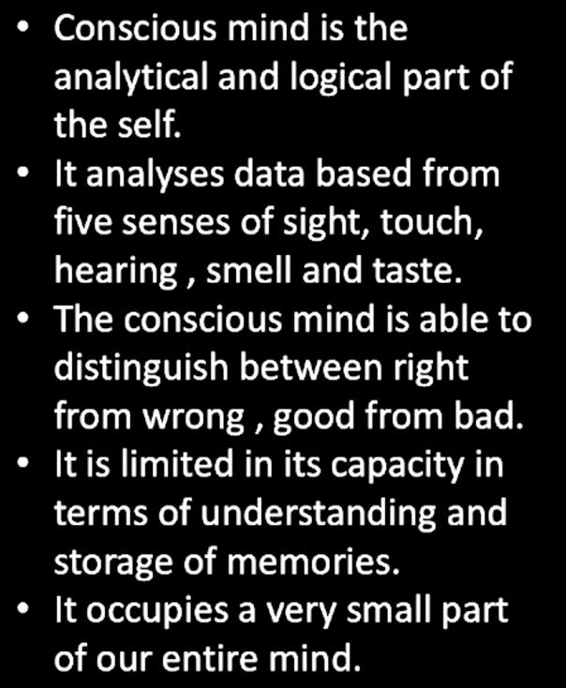

Slide 7
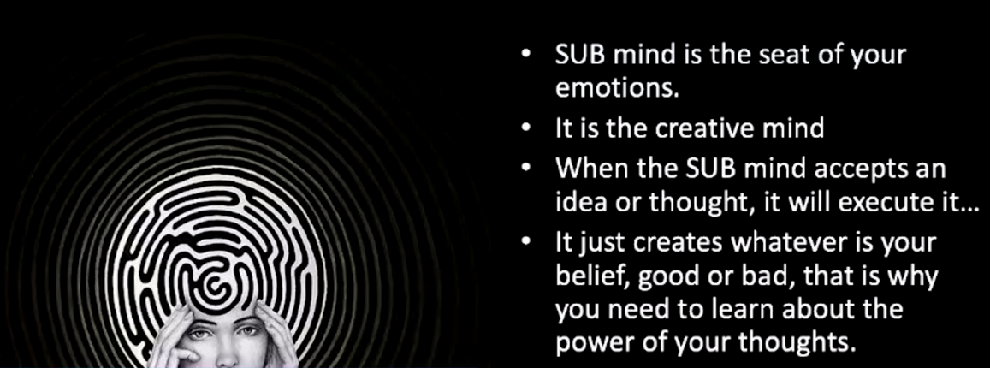
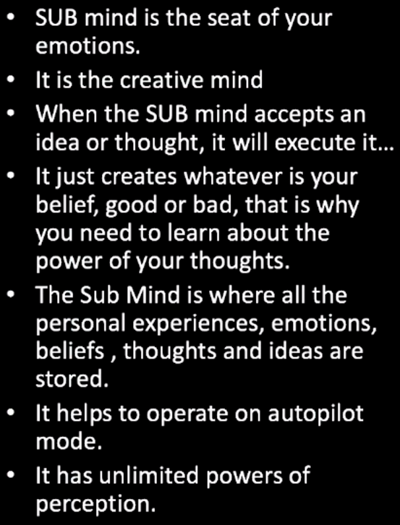

Slide 8
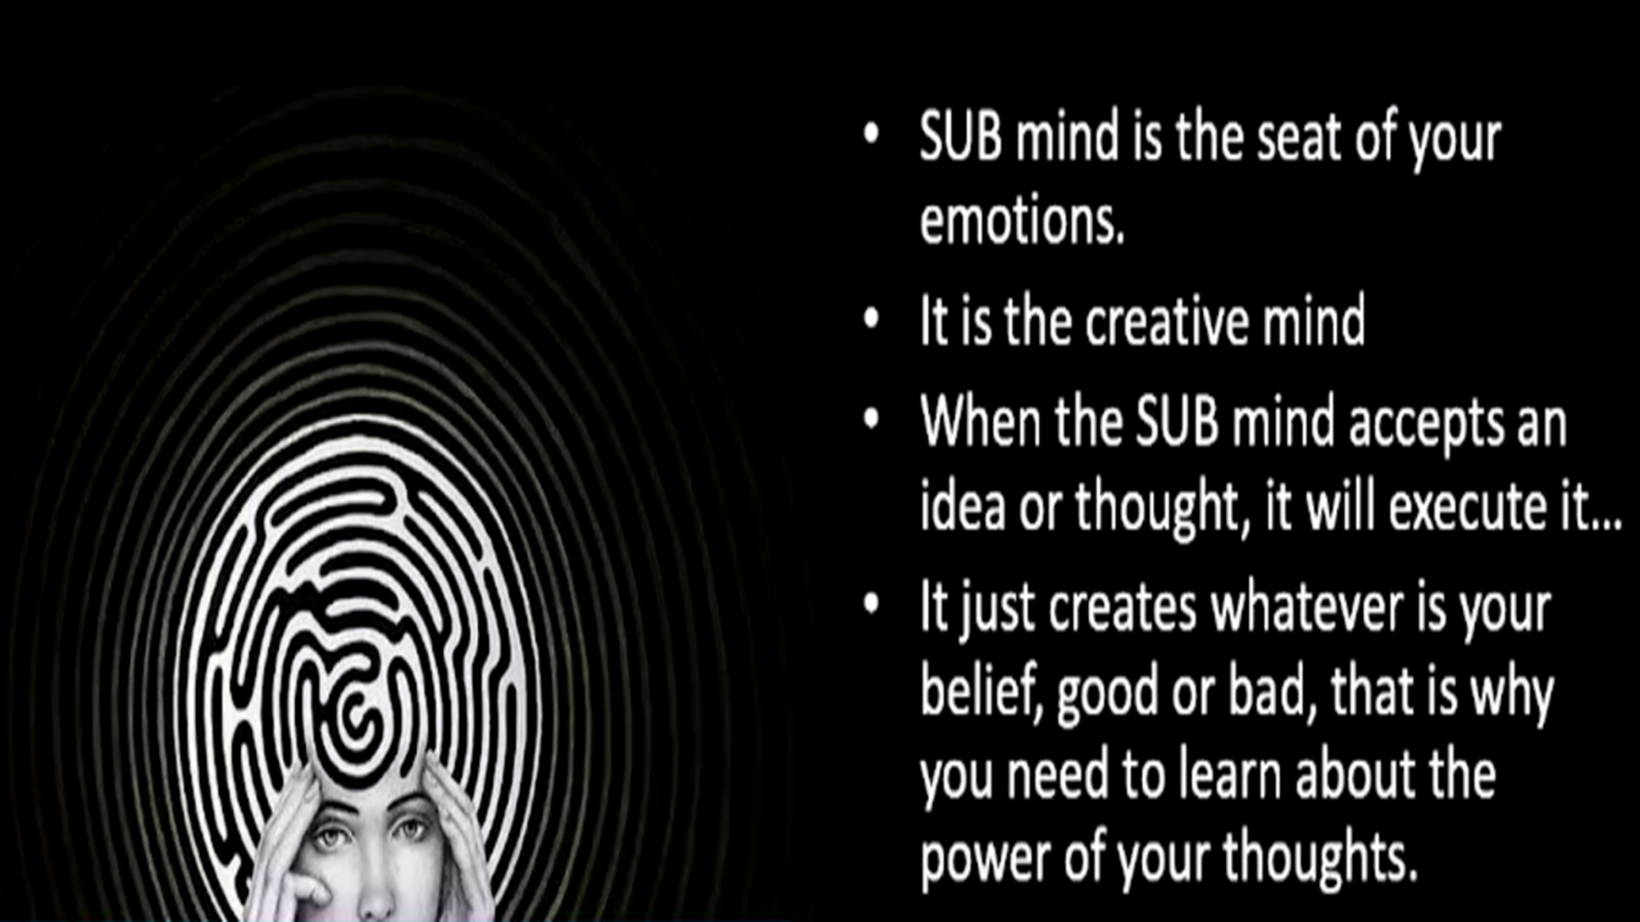

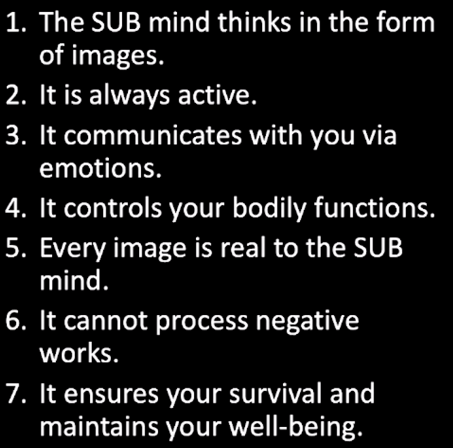

Slide 9
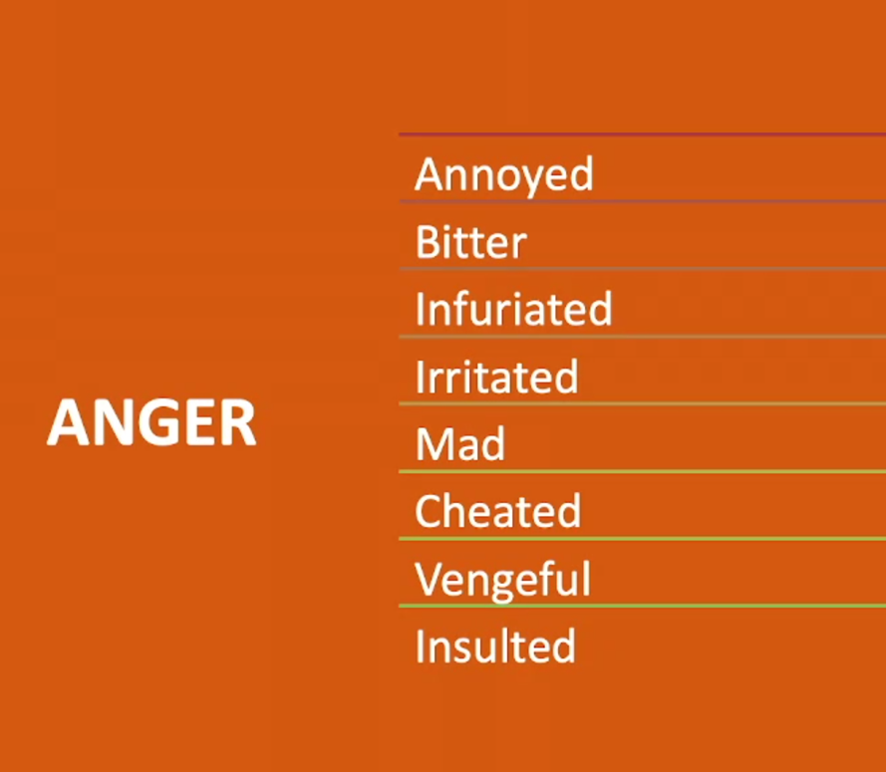

Slide 10
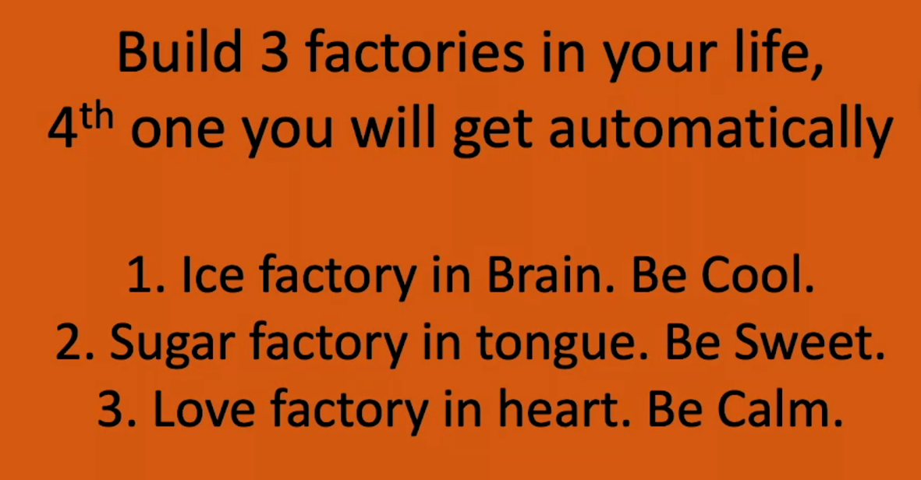


Slide 11
8 Rules for Living a Happy Life
. 1. Focus on positive 2. Forgive and forget 3. Be grateful and give blessings 4. Respond , don't react 5. Love unconditionally and be kind 6. Become deserving of something you desire. 7. Health is greatest wealth; thoughts are the greatest currency. 8. Don't compare don't expect.

Slide 12
Good Vibes leads to Good Life
0. Vibes is like a perfume that everyone can feel
1. Koi bhi baat pakad kar nahi rakhni hai
2. Kisi ki galti kamzori, ya negative cheezon ke bare me nahi bolna hai, gurd grahak banna hai
3. Satisfaction leads to happiness; contentment don't need to be dependent on what's happening outside.
4. Gratitude for these 24hrs running machine Mind and Body.
5. Remove from your life the feeling of lack
6. Content: Jo hum sunte pardte dekhte hain wo hum bante Hain
7. Food that we eat should be saatvik
8. Connecting to god's vibration

